Slide 1
Delay analysis for flights to and from MSP
Team Delorean: Chi Tran, Erik Jakubowski, Tom Brennan, Mamta Mandan

Slide 2
The Source…
Monthly data for 2017 was pulled from the Bureau of Transportation Statistics
Concatinated monthly data and merged it with CSVs containing airline information and US airport information
Scrubbed data for relevant columns based on what information we would want to know as passengers
import glob
import pandas as pd
df = pd.concat([pd.read_csv(f, low_memory=False) for f in glob.glob('Resources/1028836041*.csv')], ignore_index = True)
airlines = pd.read_csv("Resources/airlines.csv")
airports = pd.read_csv("Resources/airports.csv")
combined_df = pd.merge(df, airlines, how='left', on='OP_UNIQUE_CARRIER')
combined_df = pd.merge(combined_df, airports[['AIRPORT','IATA_CODE']], how='left', left_on = 'ORIGIN', right_on = 'IATA_CODE',suffixes=(" ","_Origin"))
combined_df=combined_df.rename(columns={"AIRPORT":"ORIGIN_AIRPORT"})
combined_df = pd.merge(combined_df, airports[['AIRPORT','IATA_CODE']], how='left', left_on = 'DEST', right_on = 'IATA_CODE',suffixes=(" ","_Origin"))
combined_df=combined_df.rename(columns={"AIRPORT":"DEST_AIRPORT"})

Slide 3

The Basics…
Number of outbound flights in a year: 145,826
Number of inbound flights in a year: 145,798
Airlines: Alaskan(AS), American(AA), Delta(DL), Endeavor(EV), Frontier(F9), Skywest(OO), Spirit(NK), Southwest(WN), United(UA)
Types of Delay Codes: Weather, Carrier, NAA, Security, Late Arriving Equipment
Number of cities flown to by all airlines: 136 domestic and 27 international markets
Data only includes Domestic US airports
NO international flights were analyzed

Slide 4
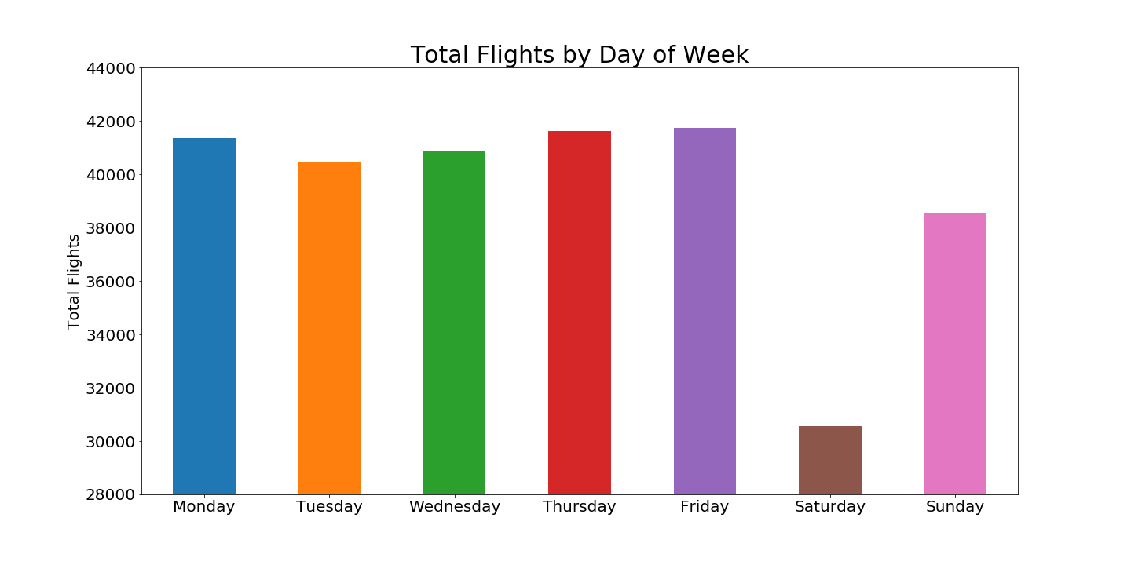

Slide 5
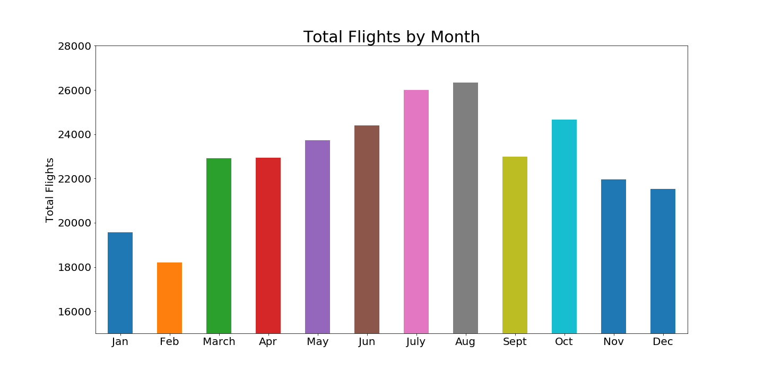

Slide 6
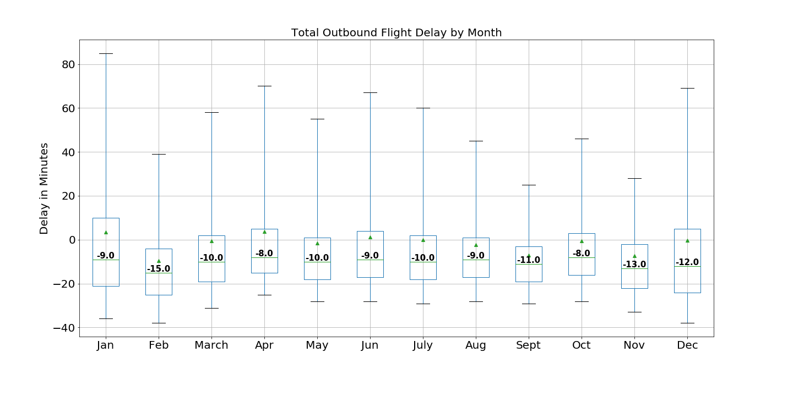

Slide 7
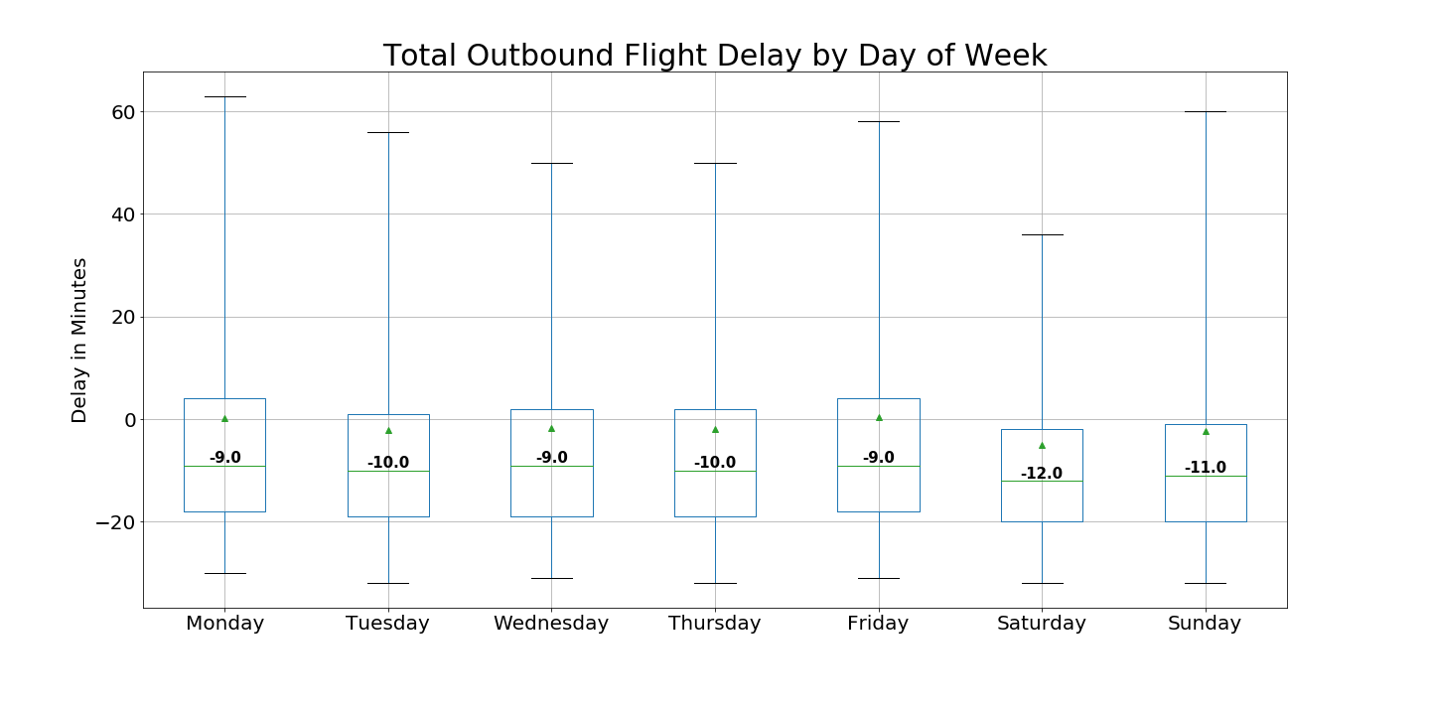

Slide 8
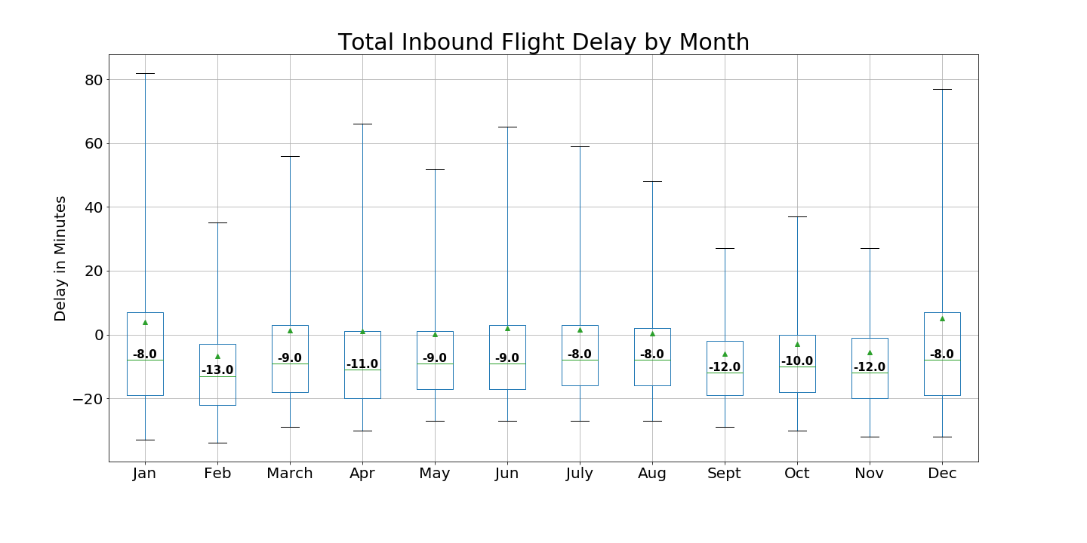

Slide 9
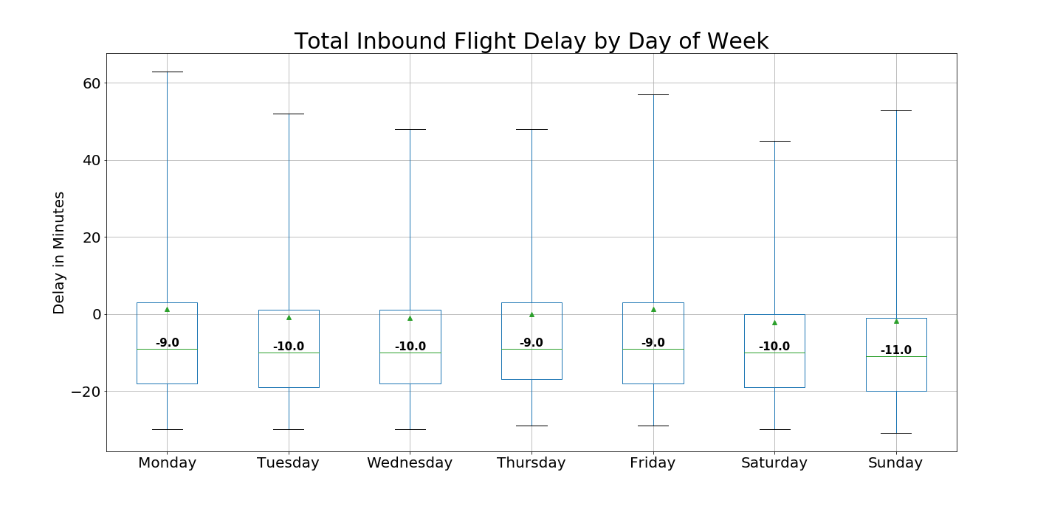

Slide 10
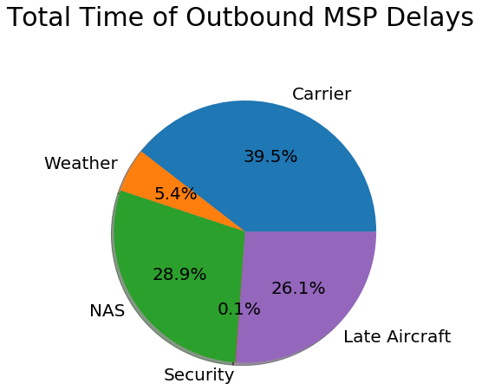

Slide 11
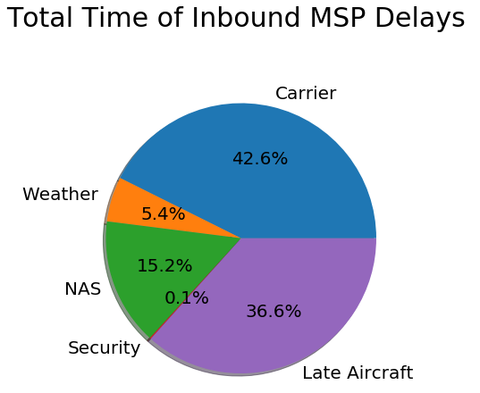

Slide 12
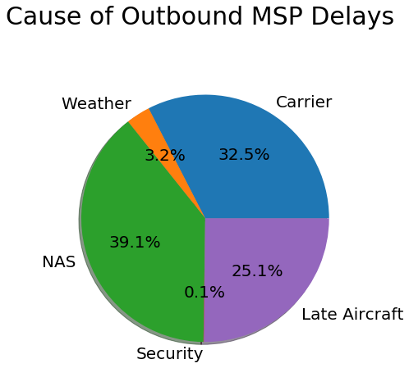

Slide 13
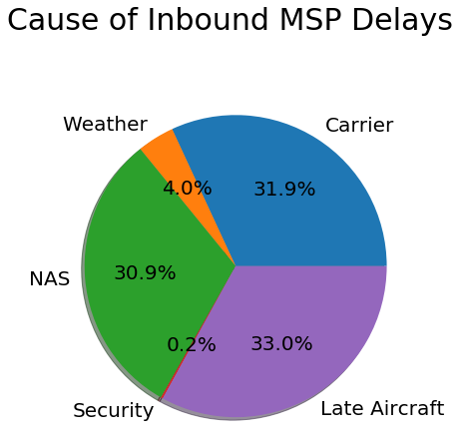

Slide 14
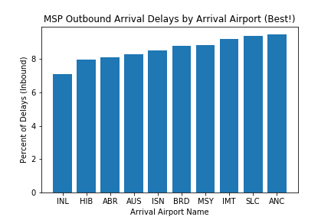

Slide 15
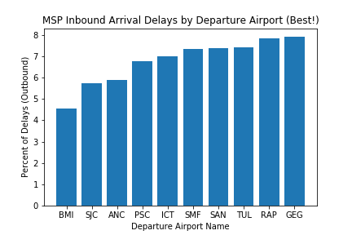

Slide 16
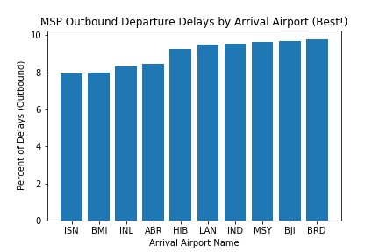

Slide 17
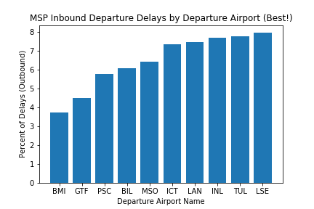

Slide 18
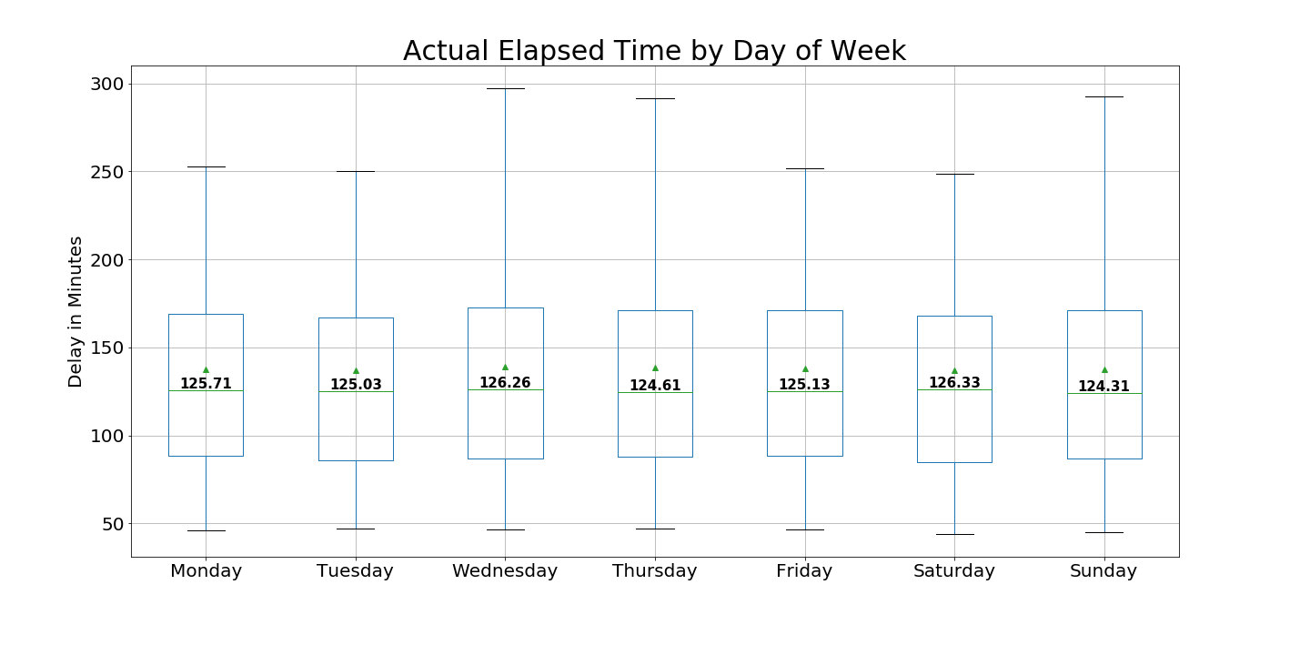

Slide 19
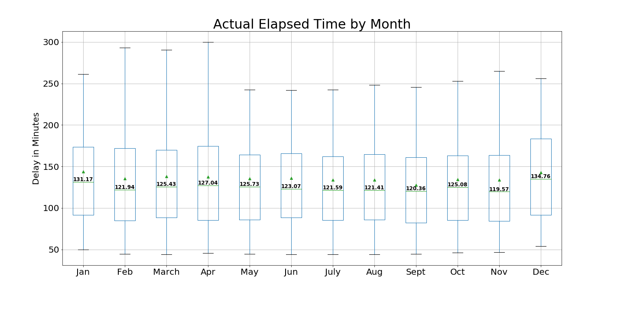

Slide 20
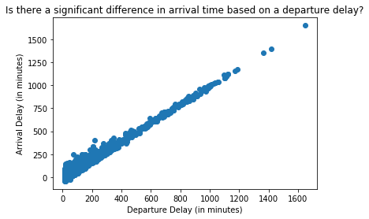

Slide 21
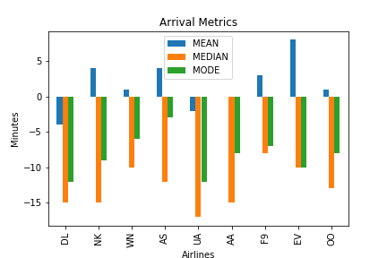

Slide 22
